Slide 1
LATEST IT TREND

Slide 2
E-COMMERCE
E-commerce (electronic commerce) is the digital process of buying and selling goods, services, or data over the internet, using platforms like websites, apps, and social media .

Slide 3
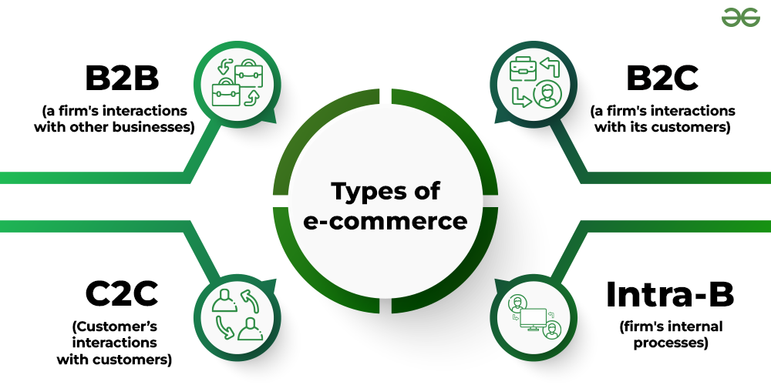

Slide 4
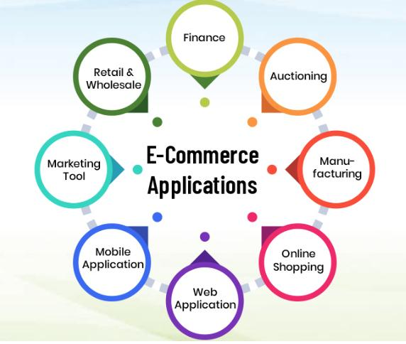

Slide 5
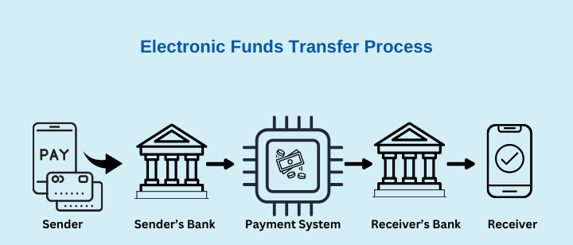
ELECTRONIC FUND TRANSFER
An Electronic Funds Transfer (EFT) is the digital movement of money between bank accounts, replacing physical cash or checks with secure electronic systems for fast, convenient transactions like direct deposits, online bill payments, ATM withdrawals, or card purchases

Slide 6
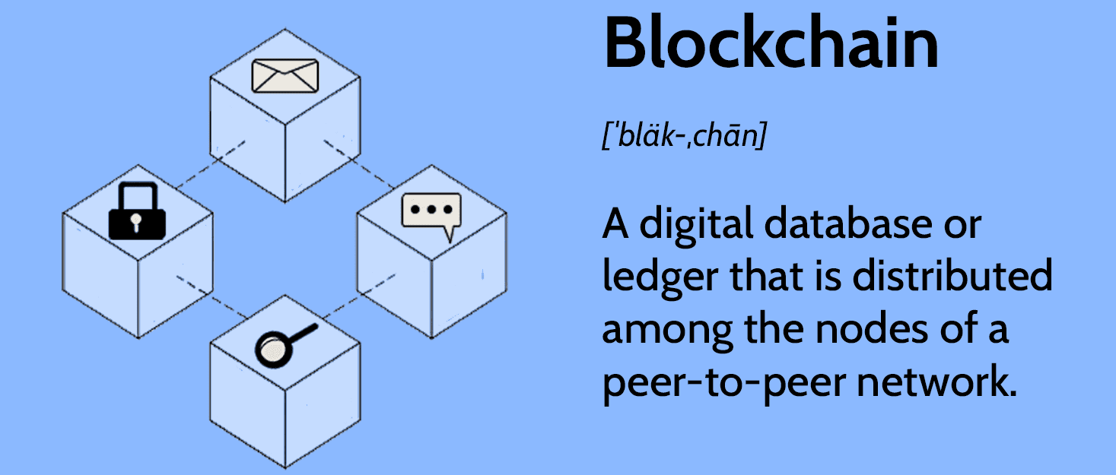
BLOCKCHAIN

Slide 7
AI→ MACHINES THAT REPLICATE HUMAN LIKE THINKING
1. EXPERT SYSTEM
2.NLP
COMMUNICATING COMPUTER PROGRAM THAT CAN SOLVE PROBLEMS WHICH WOULD OTHERWISE NEED HUMAN ASSISTANCE.
Ex- Prospector
STUDY OF METHODS BY WHICH COMPUTERS CAN RECOGNIZE AND UNDERSTAND HUMAN LANGUAGE.

Slide 8
AI→ MACHINES THAT REPLICATE HUMAN LIKE THINKING
3. INTELLIGENT AGENT
4.PATTERN RECOGNITION
COMPUTER PROGRAM THAT HAS BUILT-IN INTELLIGENCE WHICH KEEPS A CHECK ON THE WORK PATTERNS , ASK QUESTIONS AND PERFORM TASKS ON BEHALF OF USER.

Slide 9
AI→ MACHINES THAT REPLICATE HUMAN LIKE THINKING
5. INTELLIGENT APPS
6. ROBOTICS
SOFTWARE WRITTEN FOR MOBILE DEVICES BASED ON AI AND MACHINE LEARNING TECHNOLOGY.
EX-CHATBOT AND VIRTUAL ASSISTANT
SHAKEY WAS THE FIRST ROBOT TO USE AI TO NAVIGATE.

Slide 10
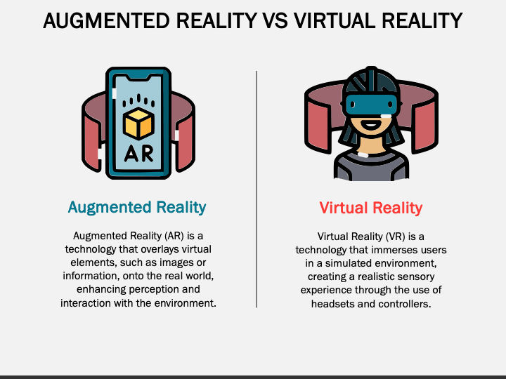

Slide 11
INTERNET OF THINGS
The Internet of Things (IoT) refers to a network of interconnected physical objects such as devices, machines, vehicles, or people embedded with sensors, software, and unique identifiers that enable them to collect, exchange, and process data over a network without requiring direct human-to-human or human-to-computer interaction.

Slide 12
3 D PRINTING
3D printing or additive manufacturing is a process of making three dimensional objects from a digital file.
APPLICATIONS OF 3D PRINTING:
I. EDUCATION
2. RAPID-PROTOTYPING METHOD
3.MEDICINE
4.CONSTRUCTION
5.ART AND JEWELLERY

Slide 13
3D PRINTING METHODS
DIRECT 3D PRINTING
BINDER 3D PRINTING
MULTI-JET MODELLING
FUSED DEPOSITION MODELLING
PHOTO-POLYMERIZATION

Slide 14
